Slide 1

Chapter 6 Green Plumbing
& Mechanical Supplement by Jeff Hutcher
Senior Plumbing & Mechanical Inspector
City of Oakland
2012 Edition
For use with all Codes

Slide 2
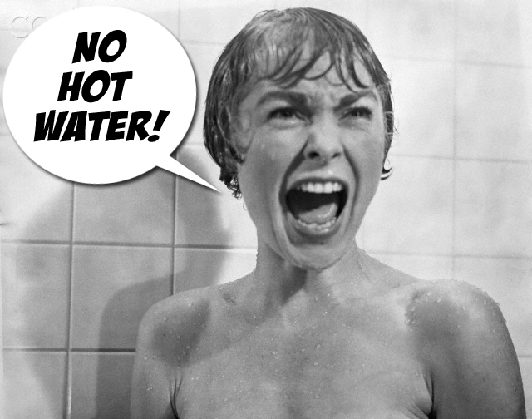

Slide 3
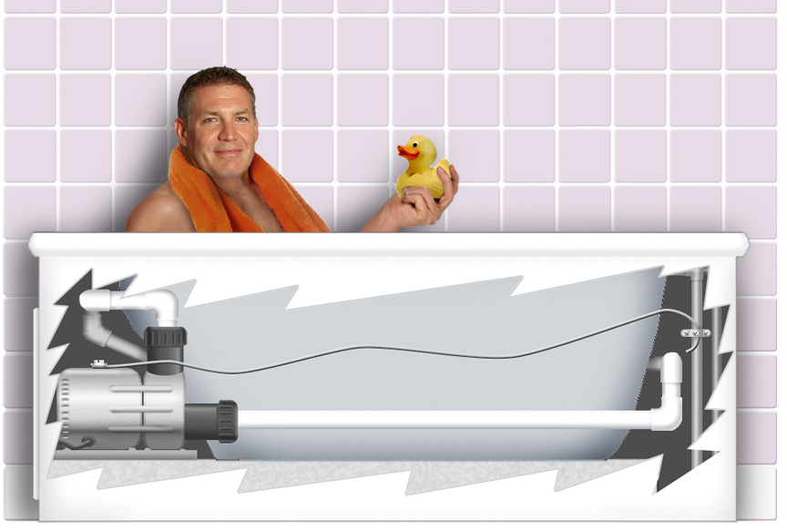
Are we going to give up our luxury items?
Courtesy of Code Check and Paddy Morrissey
Not the duck anyway.

Slide 4
Gaps
Hot water is a system –
  We need systemic thinking so that the components work together to get high performance
This is primarily a design, engineering and implementation challenge
We need one thermal engine for water heating and space conditioning
  Water heating takes the lead
  Space heating systems are needed for peak loads of 10 Btu/hour/square foot or less

Slide 5
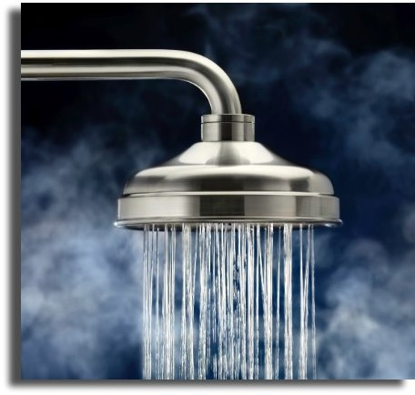
The Challenge:
Deliver hot water
to every fitting or appliance
wasting no more energy
than we currently waste and
wasting no more than 1 cup
waiting for the hot water to arrive.

Slide 6
Possible Solutions
A. Central plumbing core
  Only if all fixtures are within 1 cup of one water heater.
  Unlikely without shift in perceptions of floor plans
B. 1 water heater for every hot water fixture
  More expensive to bring energy to the water heaters than it is
  to bring plumbing. Then you have the additional cost of the heaters,
  flues, and space. Not to mention the future maintenance.
C. 2-3 water heaters per home
  Same as above. Might make sense in buildings with distant hot
  Water locations and very intermittent uses.
D. Heat trace on the pipes
  Long, skinny, under insulated water heater. Expensive to install.
  Great on water conservation. Competitive in certain applications,
  Otherwise can be expensive on energy.
Circulation loop 1 cup from every hot water fixture
Most buildable option. All circulation systems can save water,
only one can save energy.

Slide 7
To Improve the Delivery Phase:
Get hotter water sooner by minimizing the
waste of water, energy & time
Reduce the volume of water in the pipe
(smaller diameter, shorter length)
Reduce the number of restrictions to flow (decrease
“effective” length)
Increase the flow rate (use a demand-controlled pump)
Insulate the pipe (becomes critical for very low flow rates
and adverse environmental conditions)

Slide 8
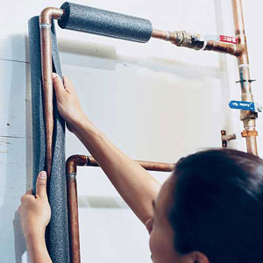
Key Strategies
  Wring out the wastes.
  • Decrease the volume between source of
  hot water and the use – instantaneousness
  • Insulate the hot water piping
  • Utilize the waste heat running down the drain
  Improve the water efficiency of the uses.
  • Reduce hot water outlet flow rates
  • Reduce the volume of hot water needed for each task
  Increase the efficiency making hot water.
  • Preheat – solar, heat pump, off-peak electric
  • Select one or more very efficient supplemental heaters that work with preheated water to reach the desired temperature and for continuousness
  • Combine water and space heating

Slide 9

Remember What People Want
Hot Water Now = “Instantaneousness”
  Need hot water available before the start of each draw.
• A tank with hot water
• Heated pipes
  Need the source of hot water close to each fixture
  or appliance
  Point of Use is not about water heater size, its about
  location
Never Run Out in My Shower = “Continuous”
  Need a large enough tank or a large enough burner or element
  Or, a modest amount of both

Slide 10
The Ideal Hot Water Distribution System
Has the smallest volume (length and smallest “possible” diameter) of pipe from the source of hot water to the hot water outlet.
Sometimes the source of hot water is the water heater, sometimes a trunk line.
How many water heaters does a building need?

Slide 11
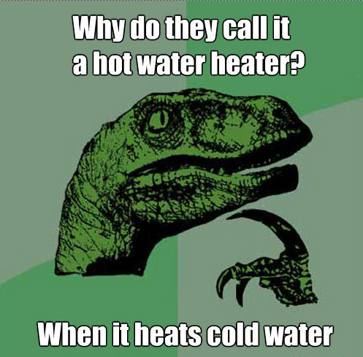

Slide 12
The Challenge:
Deliver hot water
To every hot water outlet wasting no more energy than we currently waste and wasting no more than 1 cup waiting for the hot water to arrive.

Slide 13
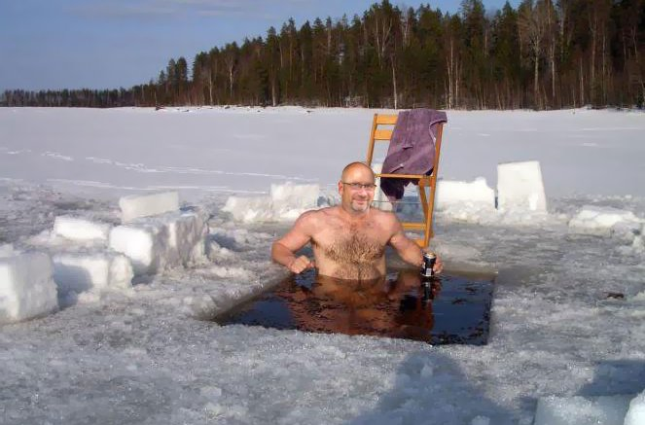
Can we eliminate our need for Hot Water?
Hace Mucho frio!
I think not!

Slide 14

Question:
If you want to waste no more than 1 cup
  while waiting for hot water to arrive,
  what is the maximum amount of water
that can be in the pipe that is not usefully hot?
Answer:
1 cup = 8 ounces = 1/16th gallon = 0.0625 gallon

Slide 15
Length of Pipe that Holds 8 oz. of Water

Slide 16
Gallons Wasted as a Function of Time
and Fixture Flow Rate

Slide 17
Gallons Wasted as a Function of Time
and Fixture Flow Rate

Slide 18
Gallons Wasted as a Function of Time
and Fixture Flow Rate

Slide 19
Neither Tank or Tankless
is Necessarily the Answer –
A combination of the two might be better:
    Burner or element
    • Sized for some amount of continuous use
    • Residential:
    Approximately 2-3 GPM
      80-120,000 Btu Natural Gas, 20-30 kW Electric
    • Commercial
    Modest tank
    • Some volume for peak conditions
    • Hot water available at the beginning of every draw
    • Enables a simpler burner control strategy
    Possible in both gas and electric
How does the water heater interact with the fixtures?

Slide 20
A “Good” Water Heater
Residential
  Does not have to be large enough for extreme peak periods, but it must have
  a large enough burner or element to keep up with the hot water needed for
  one standard shower.
  Must be able to serve an infinite number of hot water use patterns
  Typical pattern: morning rush hour, evening plateau, weekends are spread out,
  lots of small draws
Commercial
  Serves the intended loads
  Meets the requirements of the applicable codes: Health and Safety, Plumbing,
  Energy, Building, Green

Slide 21
Effective Capacity of
Tankless Water Heaters
Incoming cold water 50˚F. Hot output 120˚F.
Natural Gas – nominal 75% thermal efficiency
Electric – nominal 98% thermal efficiency
Natural Gas | Flow | Electric
20,000 Btu | 0.5 gpm | 5kW
40,000 Btu | 1 gpm | 10kW
100,000 Btu | 2.5 gpm | 25kW
200,000 Btu | 5 gpm | 50 kW
400,000 Btu | 10 gpm | 100kW
800,000 Btu | 20 gpm | 200kW

Slide 22
Hot Water Distribution Systems
Definitions
  A Twig line serves one fitting, fixture or appliance.
  A Branch line serves more than one.
  A Trunk line serves many.
  A Main line serves the house.

Slide 23
The Ideal Hot Water
Distribution System
Has the smallest volume (length and smallest “possible” diameter)
of pipe from the source of hot water to the fitting.
Sometimes the source of hot water is the water heater,
sometimes a trunk line.
For a given layout (floor plan) of hot water locations the system will have:
  The shortest buildable trunk line
  Few or no branches
  The shortest buildable twigs
  The fewest plumbing restrictions
  Insulation on all hot water pipes, minimum R-4

Slide 24
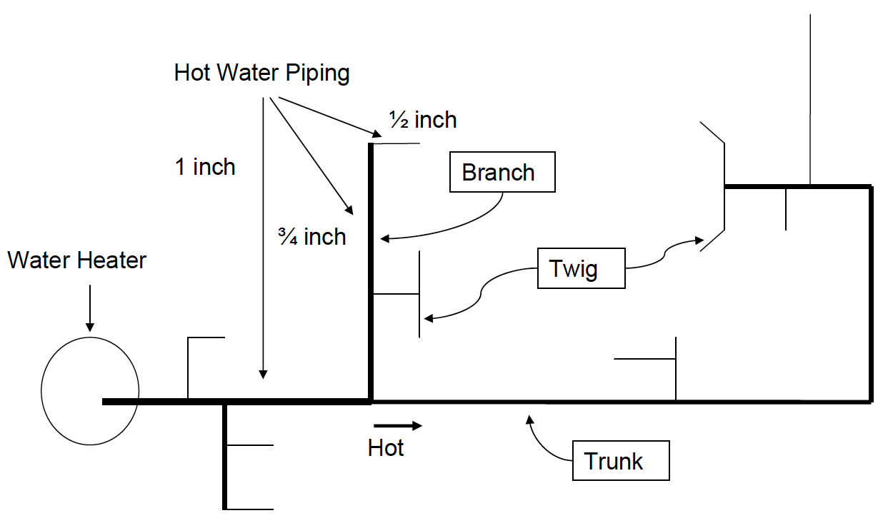
Single Trunk, Branch and Twig

Slide 25
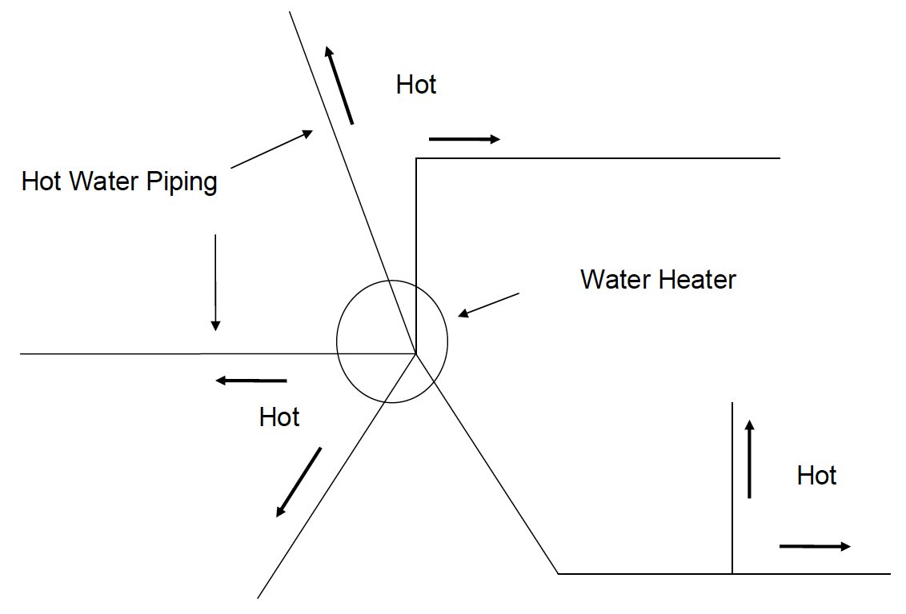
Central Plumbing Core
Radial, Manifold, Parallel Pipe

Slide 26
Radial, Manifold, Parallel Pipe-
Distributed

Slide 27
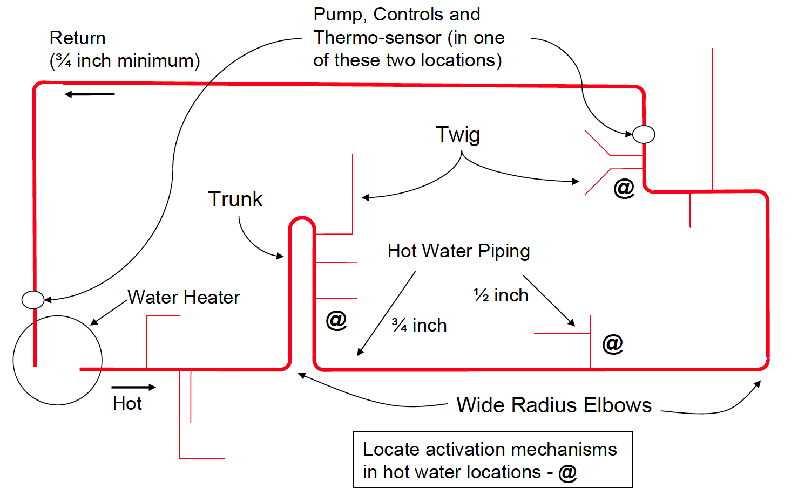
Structured Plumbing Layout
Using a Dedicated Return Line

Slide 28
Structured Plumbing
Circulation loop located close to the fittings and appliances
  Fully-heated or half-heated loop, with dedicated or cold-water return line,
  depending on floor plan
Small volume twig lines
  No larger than ½ inch diameter
    • May need larger diameter for high flow rate fittings and appliances
  No more than 10 plumbing feet long - 2 cups volume
    • Some exceptions: garden tubs, washing machines, island & peninsula sinks
Demand-controlled pumping system.
  Wired or wireless buttons or motion sensors
  Activate the pump to “prime (or preheat) the insulated line”
  Pump shuts off automatically, usually in much less than a minute
Minimum R-4 insulation on all hot water pipes.
  Water in pipes stays hot 30-60 minutes after last hot water event
Benefits:
  Minimizes the waste of water, energy and time
  The most flexible and cost effective solution for today’s floor
  plans – high customer satisfaction

Slide 29
Pipe Sizing
For House Pressure ≥ 50 psi:
  Maximum allowable velocity dictates pipe sizing.
For House Pressure ≤ 35 psi:
  Friction loss in the pipe dominates pipe sizing.
↑Flow rate →↑Pipe Size →↑Volume in Pipe →
  ↑Energy waste during the use and cool down phases
  of a hot water event.
If the pipes are sized for increased flow and a lower flow
rate fitting is used →
  ↑Energy waste during the delivery phase too.

Slide 30
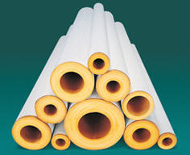
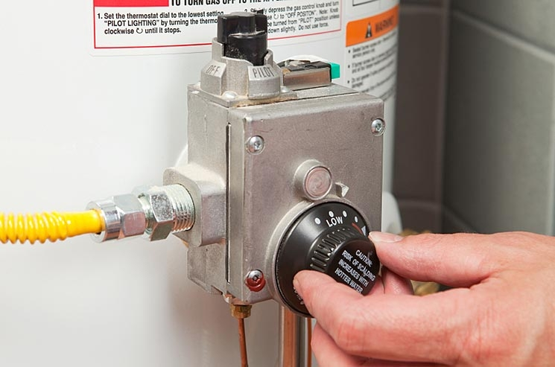
To Improve the Use Phase
Minimize the thermal losses the water
heater needs to overcome in the piping
during a hot water event.
Insulate the pipes
Increases pipe temperature and reduces heat loss during a hot water event.
This is particularly important for low flow fittings and appliances.
Take advantage of the energy savings:
Keep the water heater temperature the same and change the mix point
Reduce the water heater temperature setting.
Combine both strategies.

Slide 32
Fixture Flow Rates
Maximum allowable flow rates allowed by Green Supplement
  Shower heads: 2.0 gpm @ 80 psi
  Lavatory and kitchen faucets: 1.8- 2.2 gpm @ 60 psi
  Replacement aerators: 2.2 gpm @ 60 psi
    • Commercial Pre-rinse Spray Valves1.3 gpm @ 60 psi
    • Capable of cleaning 60 plates at not more than 30 seconds per plate
What is the future of fixture flow rates?
  Kitchen sinks – 0.5 to 2 gpm (hot only to left, pot fill)
  Lavatory sinks – 0.5 gpm (hot only to left)
  Showers – 1.5 gpm (water down drain)
  Showers – 15 gallons (maximum volume per event)

Slide 33
To improve the cool‐down phase:
Increase the availability of hot water and minimize the waste of water, energy and time
  Insulate the pipes
  Increases the time pipes stay hot between events.
  R‐4 insulation doubles cool down time with ½ inch pipe, triples it with ¾ inch pipe.
  Equal heat loss per foot, regardless of pipe diameter
  Is there a priority to insulating the pipes?
  Trunks, branches, twigs?
  Duration of hot water events?
  Time between hot water events?

Slide 34
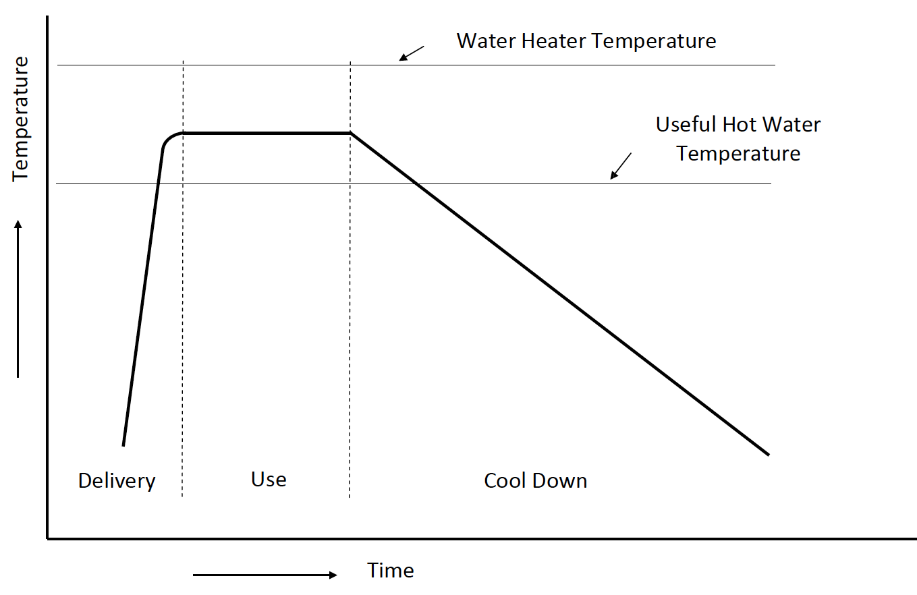
Typical Hot Water Event

Slide 35
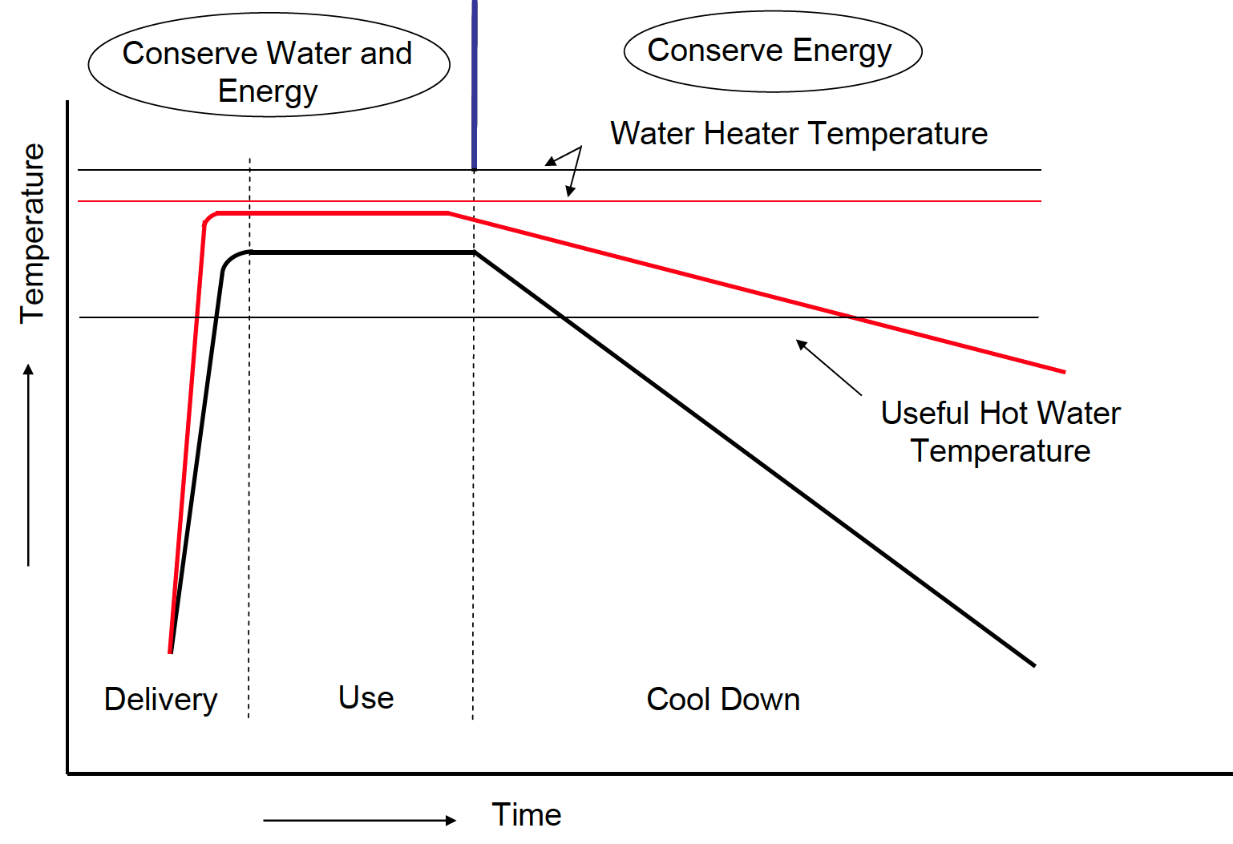
Improved Hot Water Event

Slide 36
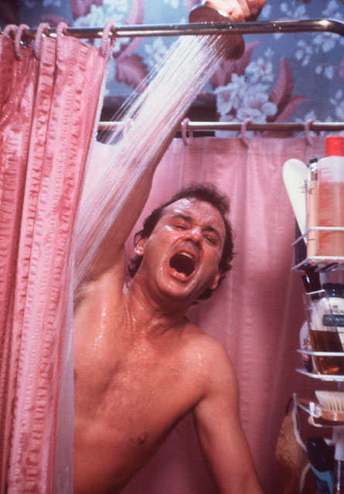
Potentially Conflicting Trends
On one hand:
Larger houses
More plumbing fittings
Increased desire for hot water
Higher expectations of performance
Desire to be Green
On the other:
Lower city water pressures
Lower fitting flow rates
Greater pressure drop in piping
Tightening of codes and standards
New policies to reduce GHG emissions
Result:
Longer wait,
Less pressure
Lower performance
Less satisfied customers
Increased complaints

Slide 37
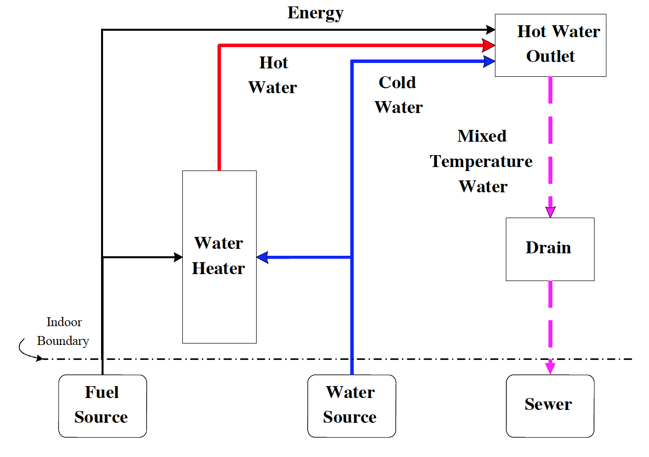
Typical Hot Water System

Slide 38
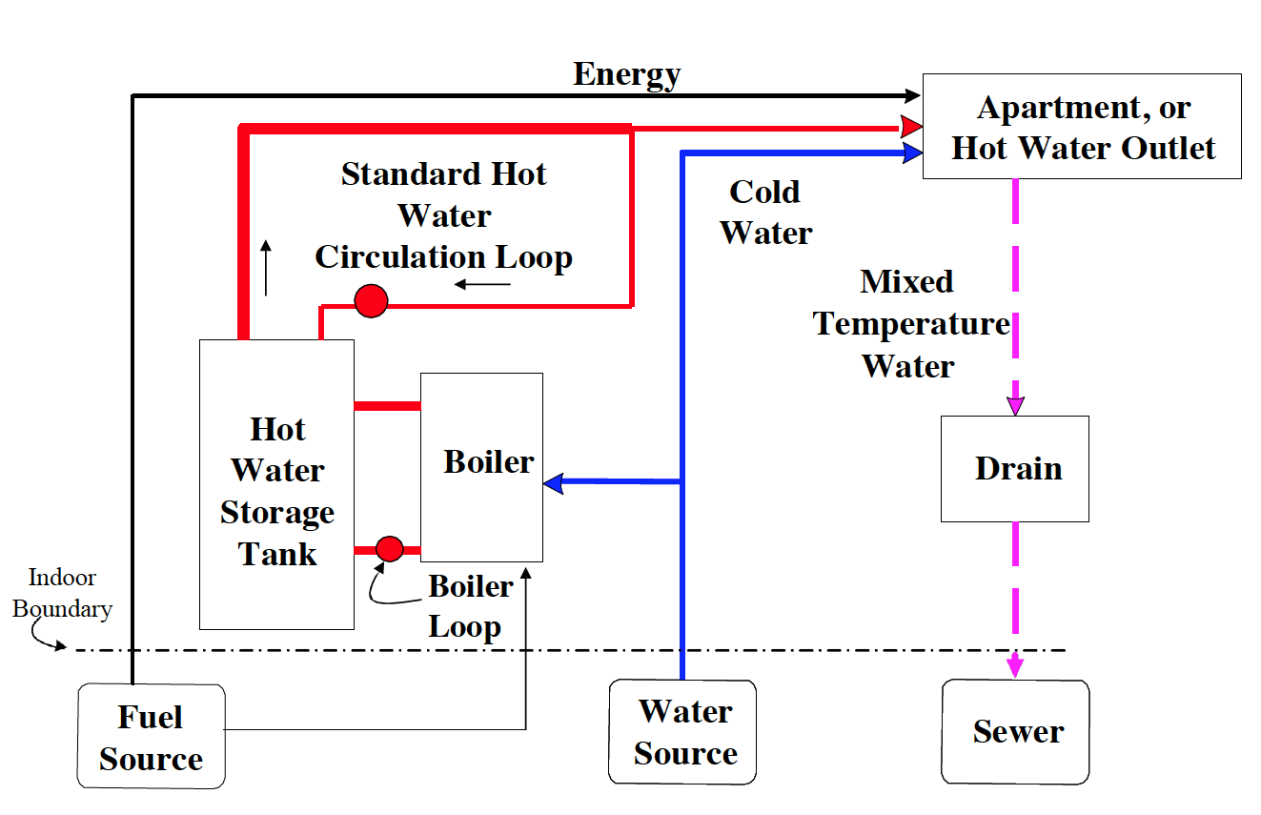
Typical Central Boiler Hot Water System

Slide 39
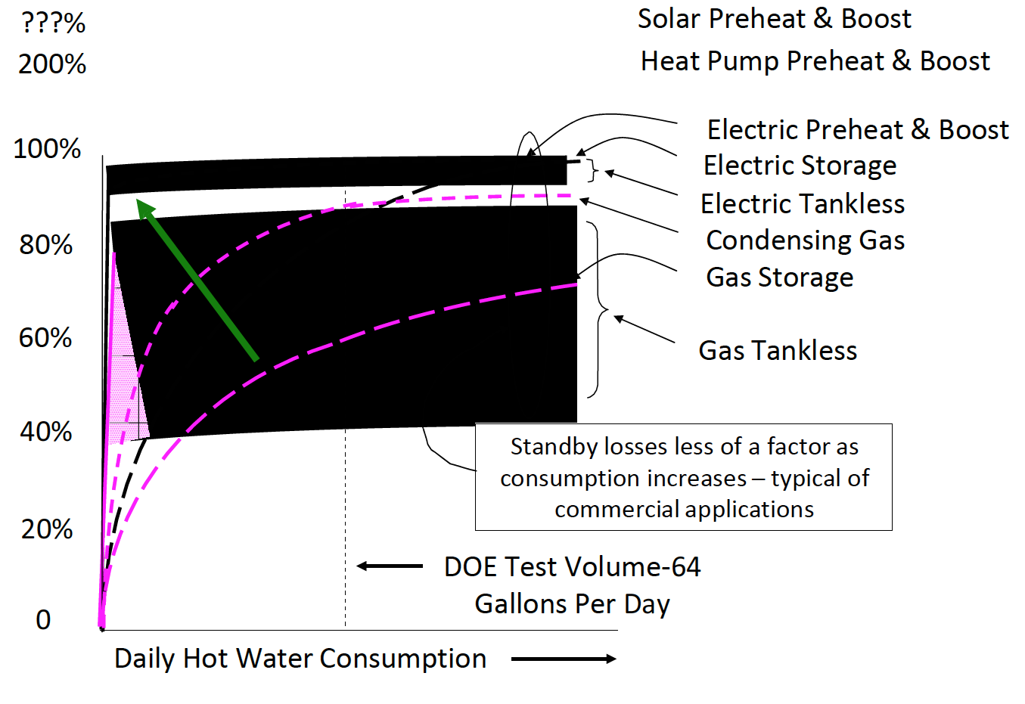
Relative Efficiency of Water Heaters

Slide 40
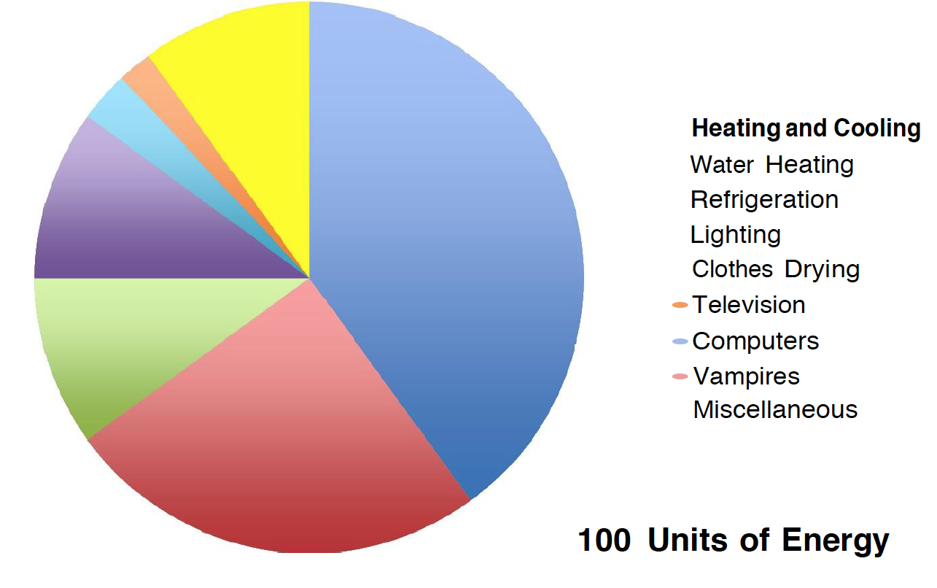
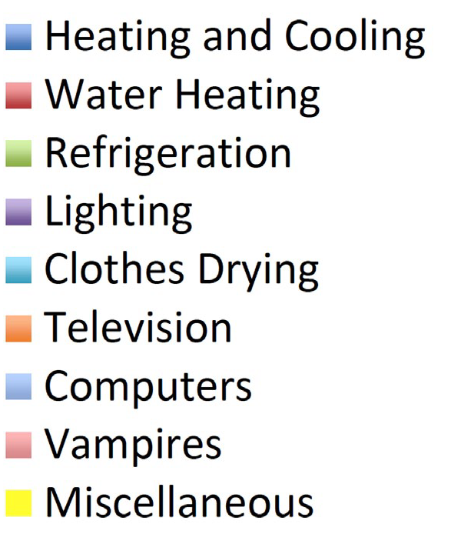
Energy Pie: 1990

Slide 41
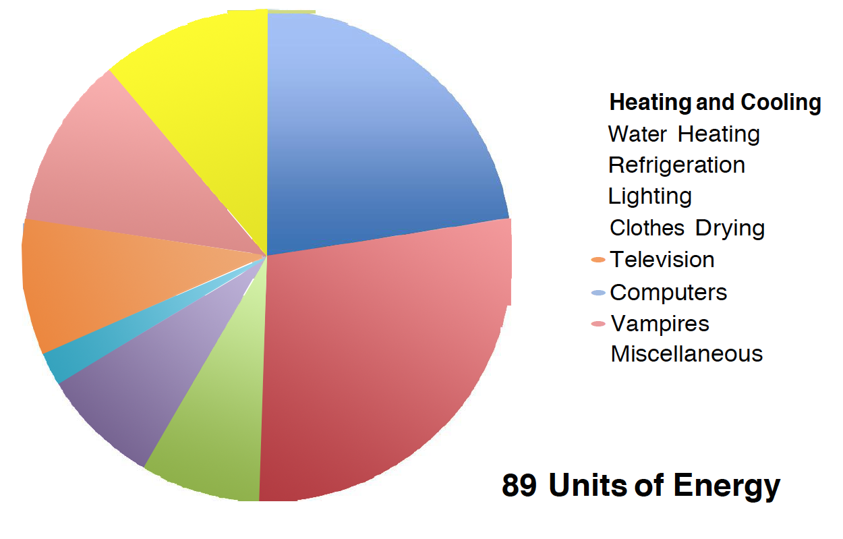
Energy Pie: 2010

Slide 42
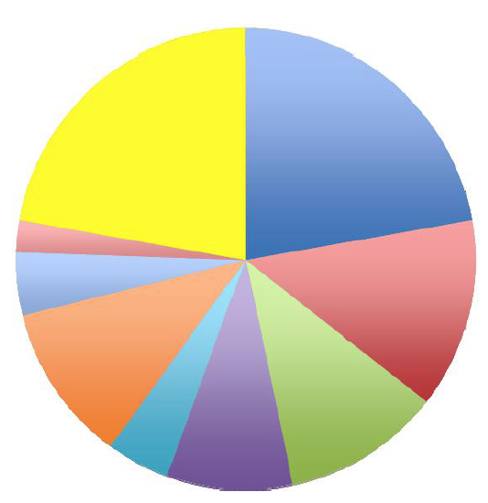
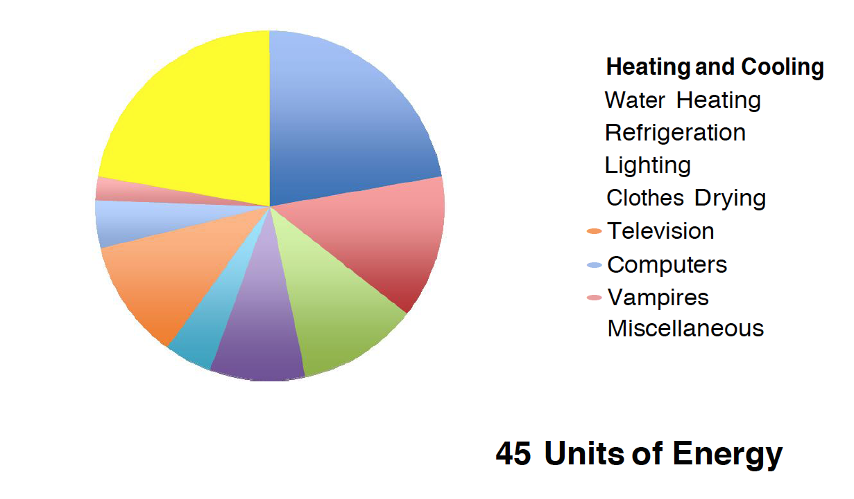
Energy Pie: 2020

Slide 43
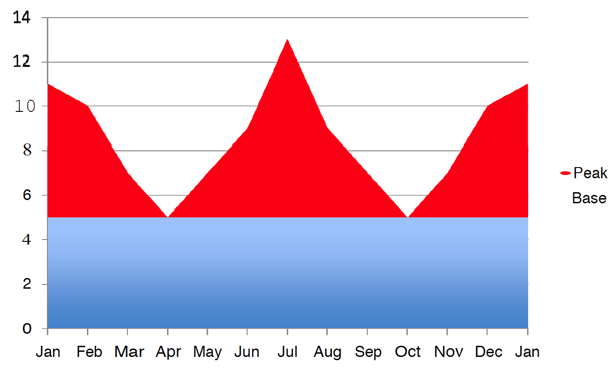
1990 Annual Energy Use Pattern

Slide 44
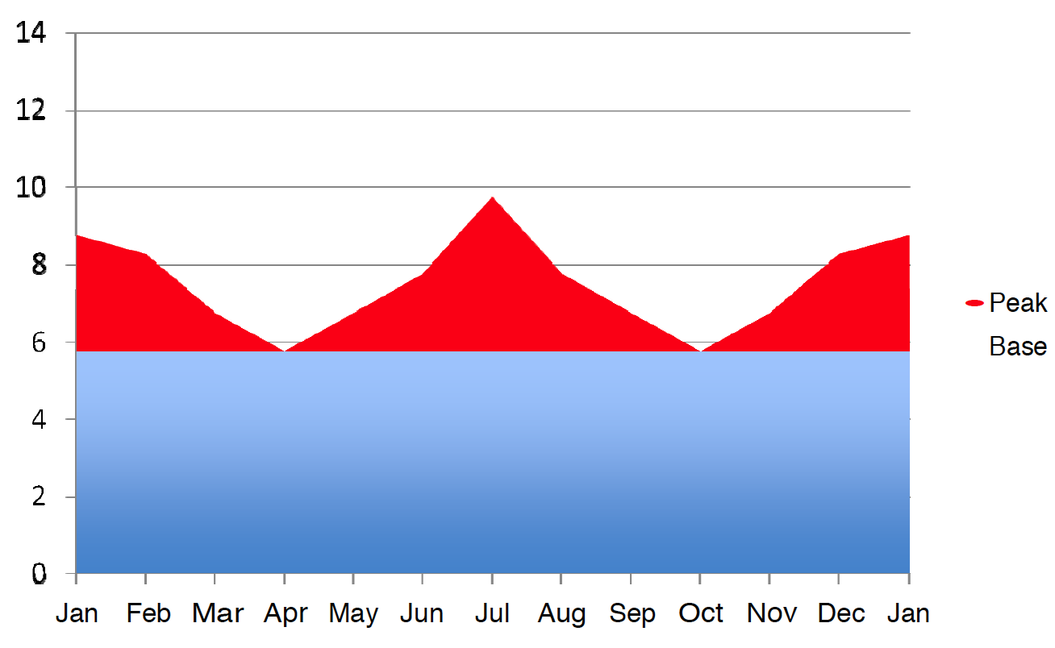
2010 Annual Energy Use Pattern

Slide 45
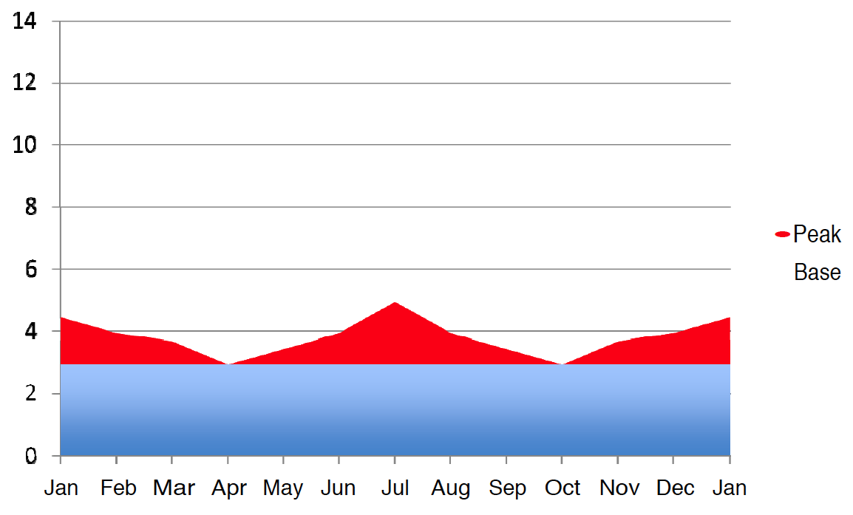
2020 Annual Energy Use Pattern

Slide 46
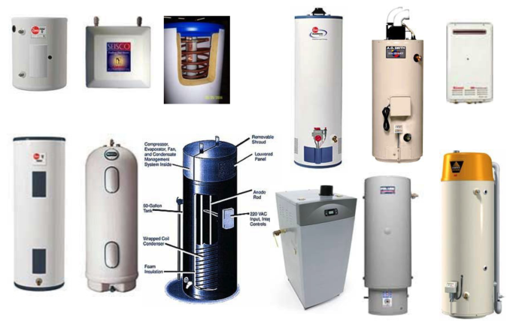
Water Heating Technologies
Electric
Gas

Slide 49
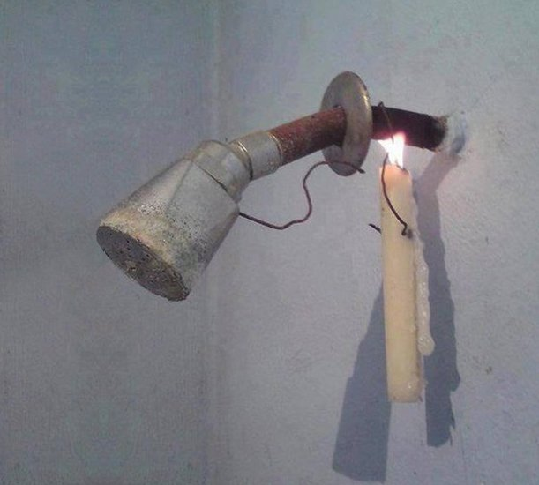
Point of Use Water Heating System

Slide 50
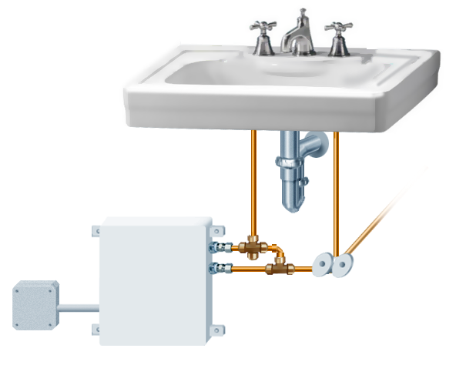
Point of Use Water Heating System
3/8” hot water
faucet feed
3/8” cold water
faucet feed
Micro mix heater
Mounting
flanges (4)
HOT
COLD
1/2” Cold water source
1/2” x 3/8”x 3/8”
Dual-handle angle stop valve
J-box
Compression fittings (2)

Slide 51
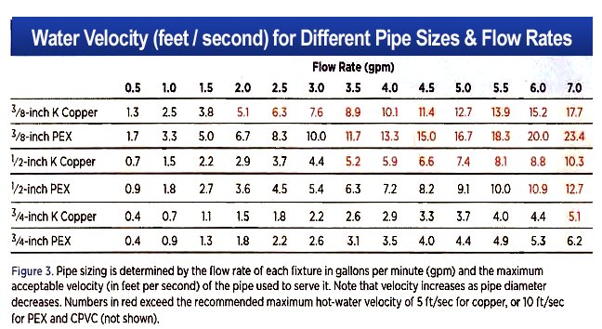

Slide 52
Hot Water Flow in ¾ in. Pipes
Flow rate affects how hot and cold water interact in the piping during hot-water delivery. A flow rate of 3 to 4 gpm creates a “plug flow” (top), which pushes cold water out of the pipe without much mixing, minimizing wasted water and time-to-tap.
At flow rates typical for many fixtures (center), hot and cold water mix reasonably well, but up to 1.5 times the standing volume of water in the pipe must flow through before hot water arrives.
At low flow rates (bottom), a thin stream of hot water rides up on top of the cold water (or spirals around it) and cools quickly, up to twice the standing volume of water must flow through the pipe to produce hot water.

Slide 53
Efficient Hot Water Piping
Minimizing the volume of water in the piping between the hot water source and each fixture is one key to reducing waste in a hot water system. To find the volume of water in piping runs of various diameters, divide the total length of each trunk, branch, or twig by the corresponding ft./cup value.
For quick approximations, divide by the “Copper rule” values in the bottom row. An efficient layout for copper will perform even better with CPVC or PEX.
Feet of Pipe per Cup (8 oz.) of Water
Pipe Type | Pipe Diameter
 | 3/8” | 1/2” | 3/4” | 1”
K copper | 9.5 | 5.5 | 2.8 | 1.6
L copper | 7.9 | 5.2 | 2.5 | 1.5
M copper | 7.6 | 4.7 | 2.3 | 1.4
CPVC | n/a | 6.4 | 3.0 | 1.8
PEX | 12.1 | 6.6 | 3.3 | 2.0
“Copper rule” | 8 | 5 | 2.5 | 1.5

Slide 54
How Long Should We Wait?
Volume in the Pipe (ounces) | MINIMUM TIME-TO-TAP (IN SECONDS) AT SELECTED FLOW RATES
 | 0.25 gpm | 0.5 gpm | 1 gpm | 1.5 gpm | 2 gpm | 2.5 gpm
2 | 4 | 1.9 | 0.9 | 0.6 | 0.5 | 0.4
4 | 8 | 4 | 1.9 | 1.3 | 0.9 | 0.8
8 | 15 | 8 | 4 | 2.5 | 1.9 | 1.5
16 | 30 | 15 | 8 | 5 | 4 | 3
24 | 45 | 23 | 11 | 8 | 6 | 5
32 | 60 | 30 | 15 | 10 | 8 | 6
64 | 120 | 60 | 30 | 20 | 15 | 12
128 | 240 | 120 | 60 | 40 | 30 | 24
ASPE Time-To-Tap Performance Criteria
 | Acceptable Performance | 1-10 seconds
 | Marginal Performance | 11-30 seconds
 | Unacceptable Performance | 31+ seconds
Source: Domestic Water Heating Design Manual, 2nd. Ed., ASPE 2003, page 234

Slide 55
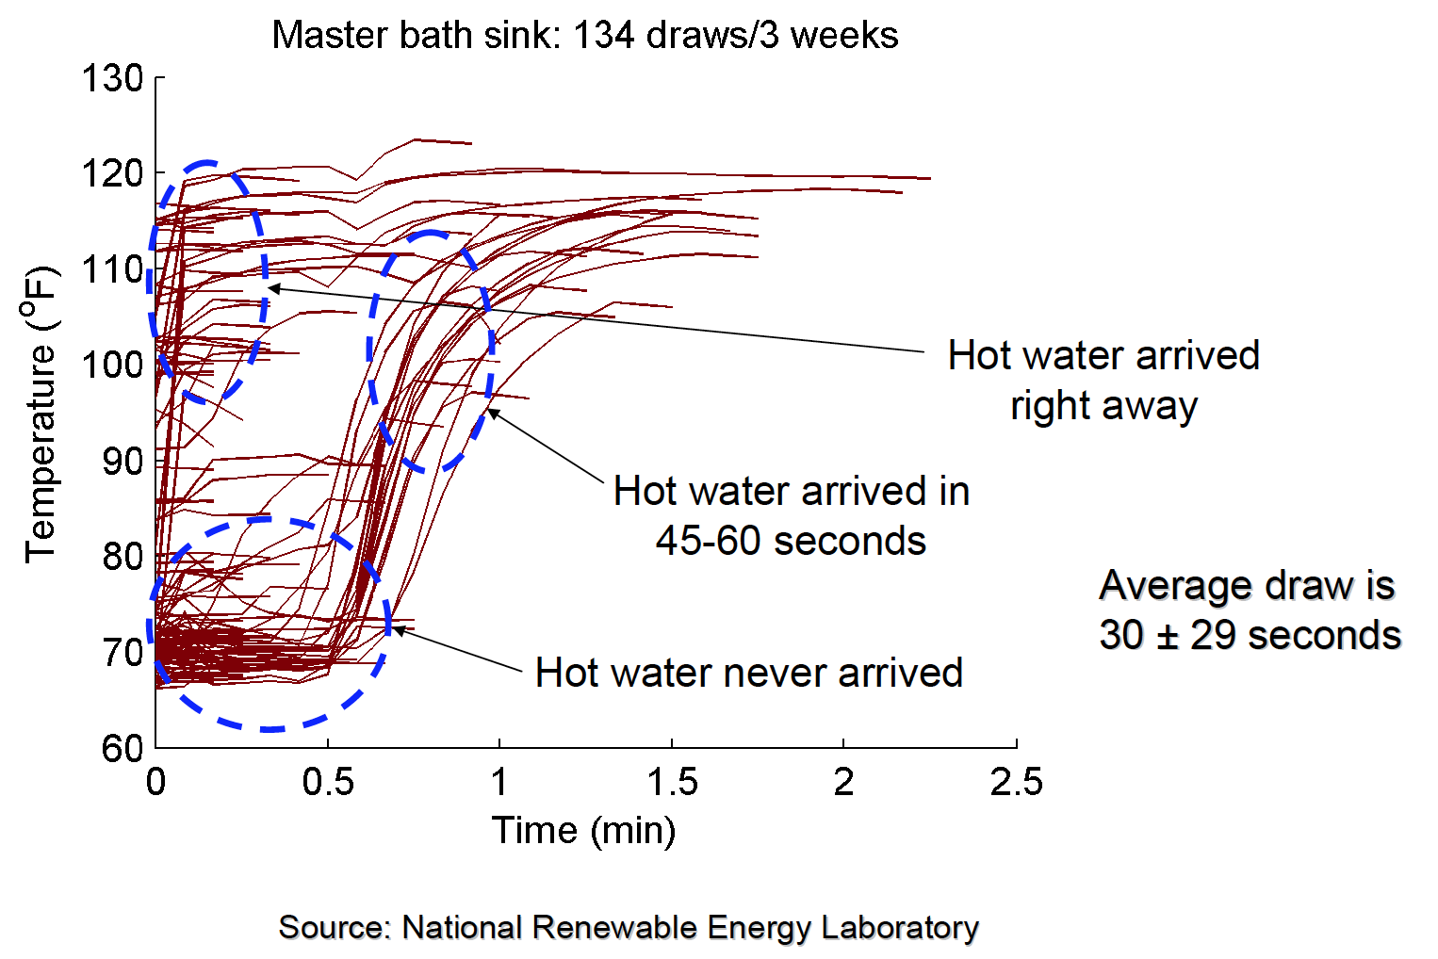
How Long Until Hot Water Arrives?

Slide 56
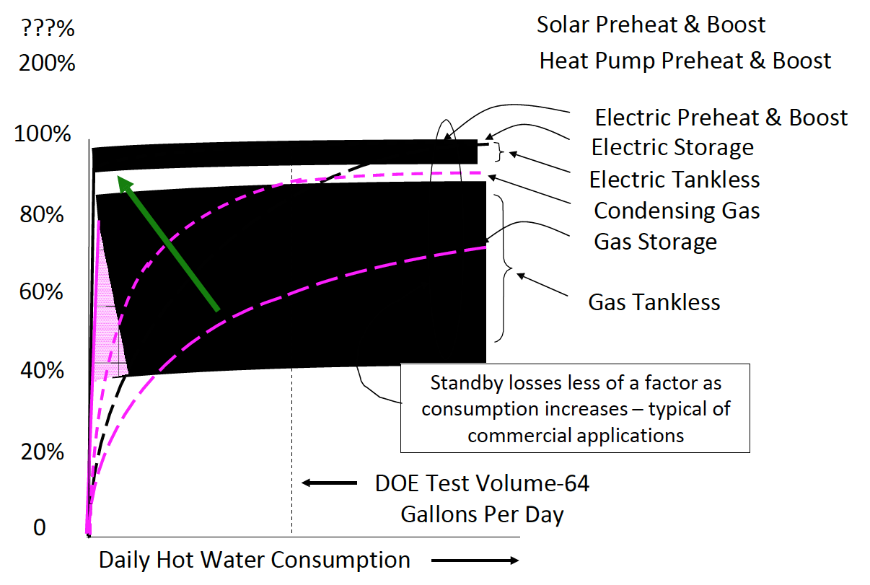
Relative Efficiency of Water Heaters

Slide 57
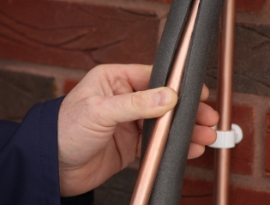
Pipe Insulation Benefits
Reduces temperature drop during periods of flow
  Reduces surface area losses
  Allows using lower temperatures
Slows cool-down rate
  Reduces number of cold starts
  Reduces volumetric losses

Slide 58
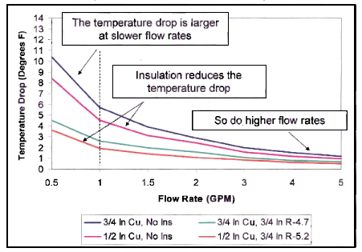
Steady-State Temperature Drop vs. Flow Rate
100 Feet of ½ & ¾ inch Copper Pipe
(Thot = 135˚ F, Tair = 67.5˚ Fzzzzz0

Slide 59
Uninsulated Pipe Heat Loss
Pipe Size, Type & Location | Heat Loss Factor - UA
 | No Flow | 0.5 GPM | 1 GPM | 2 GPM
3/8 PEX - Air | 0.345 | 0.355 | 0.368 | 0.368
½ Rigid Copper - Air | 0.226 | 0.33 | 0.345 | 0.36
½ PEX - Air | 0.438 | 0.438 | 0.438 | 0.438
½ PEX – Bundled - Air | 0.7 | 0.7 | 0.7 | 0.7
¾ Rigid Copper - Air | 0.404 | 0.41 | 0.417 | 0.421
¾ CPVC - Air | 0.44 | 0.54 | 0.46 | 0.48
¾ PEX- Air | 0.535 | 0.54 | 0.545 | 0.555
¾ PAX- Air | 0.55 | 0.546 | 0.541 | 0.532
¾ Roll Copper - Air | 0.334 | 0.334 | 0.334 | 0.334
¾ Roll Copper - Buried | 1.2 | 1.8 | 2.1 | 2.4

Slide 60
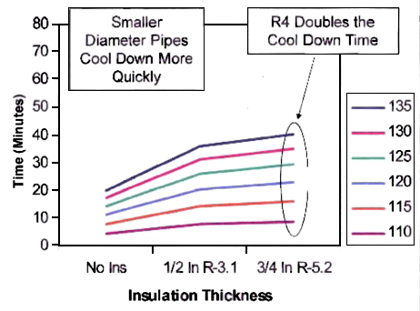
Time for Temperature to Drop to
105˚F in ½ inch Copper Pipe

Slide 61
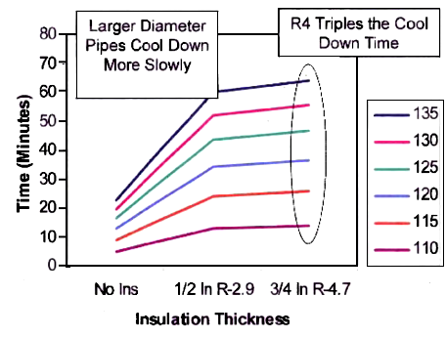
Time for Temperature to Drop to
105˚F in ¾ inch Copper Pipe

Slide 62
The Importance of Minimizing
Pipe Volume Cool-Down
 |  |  |  | Volume in Pipe That Cools Down
 |  |  | Gallons | 0.0625 | 0.125 | 0.25 |  | 0.5 |  | 0.75 | 1 | 1.5 | 2
 |  |  | Cups | 1 | 2 | 4 |  | 8 |  | 12 | 16 | 24 | 32
Heat Loss
Btu / Year |  | Btu / Day |  | Number of Times Per Day that Water in Pipe Cools Down
500,000 |  | 1,370 |  | 53 | 26 |  | 13 |  | 7 | 4.4 | 3.3 | 2.2 | 1.6
1,000,000 |  | 2,740 |  | 105 | 53 |  | 26 |  | 13 | 9 | 7 | 4.4 | 3.3
1,500,000 |  | 4,110 |  | 158 | 79 |  | 39 |  | 20 | 13 | 10 | 7 | 5
2,000,000 |  | 5,479 |  | 210 | 105 |  | 53 |  | 26 | 18 | 13 | 9 | 7
2,500,000 |  | 6,849 |  | 263 | 132 |  | 66 |  | 33 | 22 | 16 | 11 | 8
3,000,000 |  | 8,219 |  | 316 | 158 |  | 79 |  | 39 | 26 | 20 | 13 | 10
3,500,000 |  | 9,589 |  | 368 | 184 |  | 92 |  | 46 | 31 | 23 | 15 | 12
4,000,000 |  | 10,959 |  | 421 | 210 |  | 105 |  | 53 | 35 | 26 | 18 | 13
4,500,000 |  | 12,329 |  | 474 | 237 |  | 118 |  | 59 | 39 | 30 | 20 | 15
5,000,000 |  | 13,699 |  | 526 | 263 |  | 132 |  | 66 | 44 | 33 | 22 | 16
5,500,000 |  | 15,068 |  | 579 | 289 |  | 145 |  | 72 | 48 | 36 | 24 | 18
6,000,000 |  | 16,438 |  | 631 | 316 |  | 158 |  | 79 | 53 | 39 | 26 | 20

Slide 63
The Importance of Minimizing
Pipe Volume Cool-Down
 |  |  |  | Volume in Pipe That Cools Down
 |  |  | Gallons | 0.0625 | 0.125 | 0.25 |  | 0.5 |  | 0.75 | 1 | 1.5 | 2
 |  |  | Cups | 1 | 2 | 4 |  | 8 |  | 12 | 16 | 24 | 32
Heat Loss
Btu / Year |  | Btu / Day |  | Number of Times Per Day that Water in Pipe Cools Down
500,000 |  | 1,370 |  | 53 | 26 |  | 13 |  | 7 | 4.4 | 3.3 | 2.2 | 1.6
1,000,000 |  | 2,740 |  | 105 | 53 |  | 26 |  | 13 | 9 | 7 | 4.4 | 3.3
1,500,000 |  | 4,110 |  | 158 | 79 |  | 39 |  | 20 | 13 | 10 | 7 | 5
2,000,000 |  | 5,479 |  | 210 | 105 |  | 53 |  | 26 | 18 | 13 | 9 | 7
2,500,000 |  | 6,849 |  | 263 | 132 |  | 66 |  | 33 | 22 | 16 | 11 | 8
3,000,000 |  | 8,219 |  | 316 | 158 |  | 79 |  | 39 | 26 | 20 | 13 | 10
3,500,000 |  | 9,589 |  | 368 | 184 |  | 92 |  | 46 | 31 | 23 | 15 | 12
4,000,000 |  | 10,959 |  | 421 | 210 |  | 105 |  | 53 | 35 | 26 | 18 | 13
4,500,000 |  | 12,329 |  | 474 | 237 |  | 118 |  | 59 | 39 | 30 | 20 | 15
5,000,000 |  | 13,699 |  | 526 | 263 |  | 132 |  | 66 | 44 | 33 | 22 | 16
5,500,000 |  | 15,068 |  | 579 | 289 |  | 145 |  | 72 | 48 | 36 | 24 | 18
6,000,000 |  | 16,438 |  | 631 | 316 |  | 158 |  | 79 | 53 | 39 | 26 | 20

Slide 64
Water = Energy
10 gallons of water lost through normal hot water distribution represents
1 kilowatt-hour of energy.
As with inefficient distribution systems and inevitable water waste, the
embedded energy is also lost down the drain.
According to the U.S. Environmental Protection Agency‘s (EPA) Green Lights
program, production and consumption of electricity is directly linked to air
quality and carbon footprint.
On average, every kilowatt-hour of electricity emits:
  1.5 POUNDS OF CARBON DIOXDE
  5.8 GRAMS OF SULFUR DIOXIDE
  2.5 GRAMS OF NITROGEN OXIDES

Slide 65
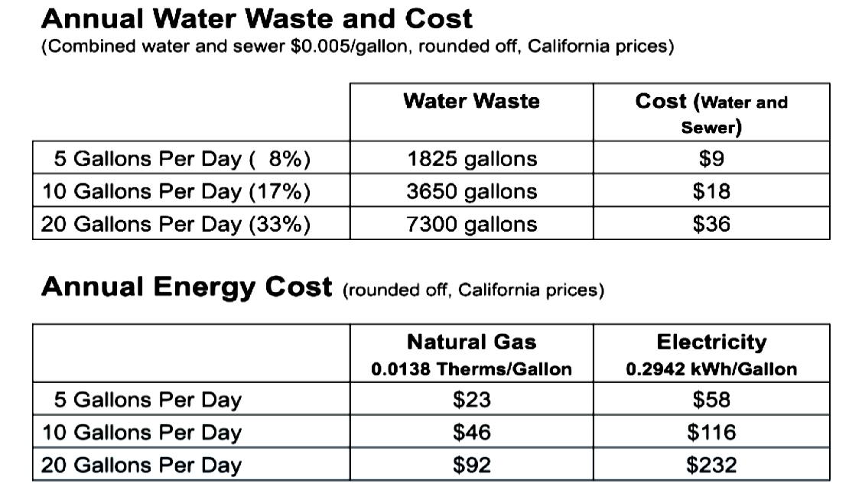
Impacts on Costs and Resources
A little waste in one household leads to a lot of waste across society.
A little improvement makes a big impact to resource sustainability.

Slide 66
On Demand Pumps: A Viable Solution
for Sustainable Design
How much money can be saved in the US by using
demand pumps in single family homes?

Slide 67
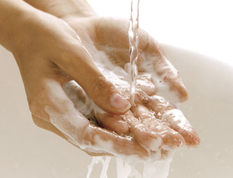
Sustainable Design & Meeting our Needs
Sometimes we don‘t think about sustainability of our water distribution,
but oftentimes a more sustainable design contributes to what we really
want from hot water, which is:
Advances in sustainable distribution design, such as demand pump systems,
have the double benefit of saving our resources and meeting our needs conveniently!
Clean clothes
Clean dishes
Clean hands
Clean body
Relaxation
Enjoyment

Slide 68
Do Our Expectations of Hot Water
Align with Sustainability?
What do we expect from hot water systems?
What demand controlled pump systems provide:
Proper water temperature prevents energy waste and also preserves our
health and safety.
Having more reliable systems means less maintenance and repair costs.
Convenience means we are waiting less for hot water and thus
saving water.
Safety
Not too hot
Not too cold
No harmful bacteria
or particulates
Sanitation
Reliability
Last forever
Low cost
Little or no
maintenance
Convenience
Adjustable temperature
and flow
Never run out
Quiet
Hot water now

Slide 69
When Is Recirculation Not Needed?
In buildings where the fixtures are close to the water heating source and where
there is a small volume water in the pipes between the fixture and the water
heater may not need a pump to recirculate water.
Not having recirculation is only possible when the volume of water that needs to
be drained is small because the amount of time it takes to get hot water is
dependent on the fixture flow rate and the volume.
For example if there is 3 gallons of water (volume) in the piping, and the faucet
has a 1 gallon per minute flow rate, it will take the user 3 minutes to drain that
water and thus get hot water.

Slide 70
Why You Need Circulation
No recirculation is only recommended if all the fixtures are within 1 gallon of the
water heater. In most cases this is not possible.
By not using recirculation the user will be foregoing getting hot water quickly.
This results in tremendous water waste. How much? In a typical home, this can
be roughly 12,000 gallons per year.
In a commercial/multifamily building this can be hundreds of thousands of gallons
of water waste. In fact, recirculation is required in large structures because the wait
time without recirculation can be 10 minutes or more and some tenants may never
even get hot water.
So what are the options?

Slide 71
Methods for Distributing Hot Water
and Effects on Water and Energy
Distribution Method | Water | Energy
Non-Recirculated | Wasteful | Efficient, if works
Continuous Recirculation | Efficient | Wasteful
Timer-Controlled Recirculation | Wasteful / Efficient, depending on the time | Wasteful / Efficient, depending on the time
Temperature-Controlled Recirculation | Efficient | Wasteful
Demand-Controlled Recirculation | Efficient | Wasteful

Slide 72
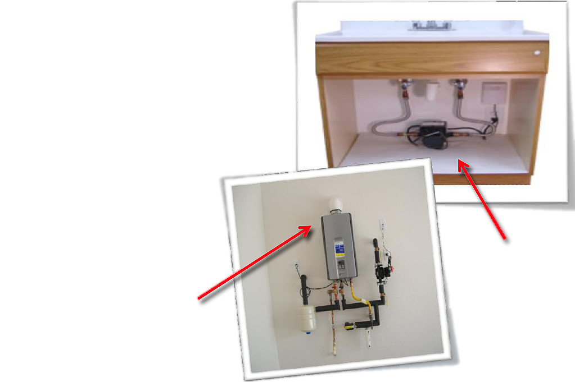
Recirculated Distribution
Recirculation pumps, again, reduce the wait
for hot water.
They can be installed in both new and existing
construction, either at the furthest fixture where
the hot and cold water pipes dead end or on a
dedicated return line.
Many times, the recirculation pump is
left running continuously, so that hot
water is always at every tap
without any wait time
whatsoever.
Retrofit
application
Dedicated
return line

Slide 73
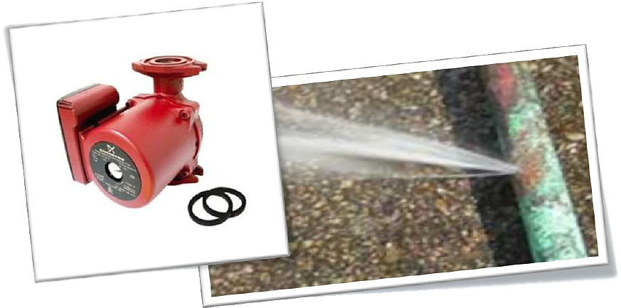
Distribution with Continuous Recirculation
Continuous recirculation solves the problem of having to drain unacceptable
amounts of water or waiting an unacceptable time to get hot water.
However, it has three major drawbacks:
  Uses energy–a pump is needed which consumes electricity
  Continuous movement of hot water will wear away at the pipes
  and water heater
  It wastes tremendous water heating energy from heat losses
  in the pipe.

Slide 74
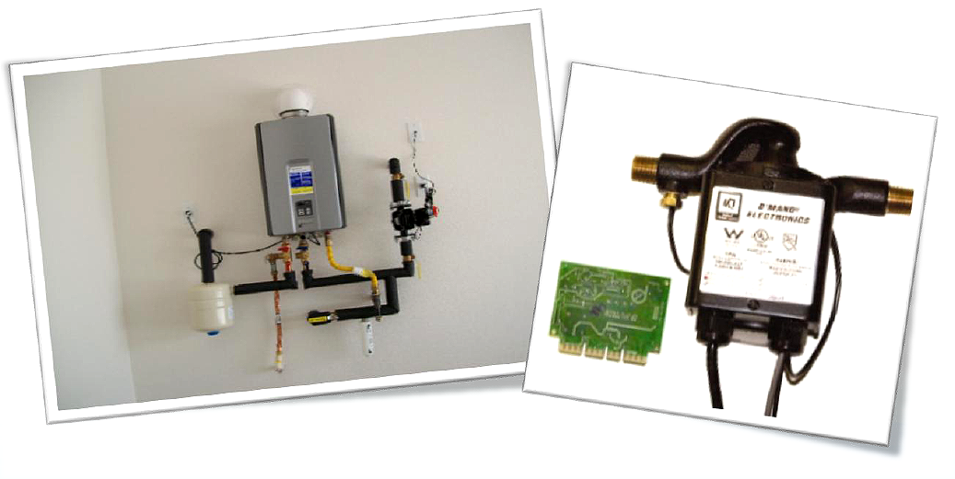
Distribution with Controlled Recirculation
Because running the pump continuously is both unnecessary and highly energy
intensive, controls may be put on the pump to automatically turn it off when it
does not need to run.
This is the most sustainable way to design the hot water distribution system.
However, some control methods are more efficient than others.

Slide 75
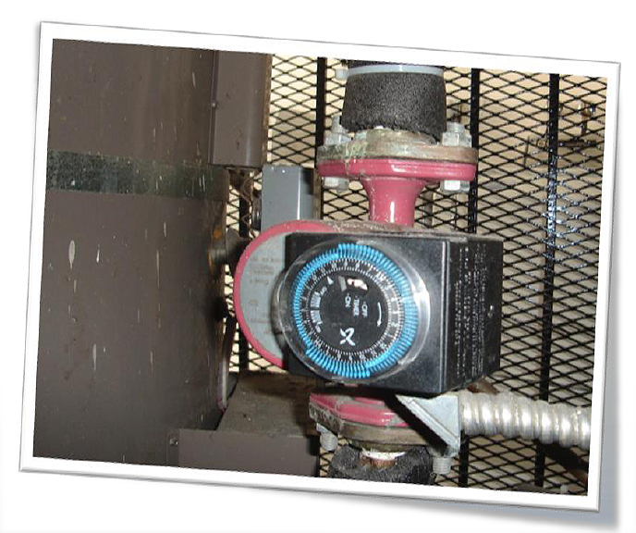
Timer-Controlled Recirculation
Turns on and off according to time schedule
Will not work if user demands hot water during "off" period
Often a guessing game; timers are often disconnected because
it‘s hard to schedule the need for hot water
Still wastes water and energy
A non-sustainable solution,
as it runs the pump too much when its “on”
creating unnecessary heat losses and runs
the pump too little when it’s “off” creating
unnecessary water waste

Slide 76
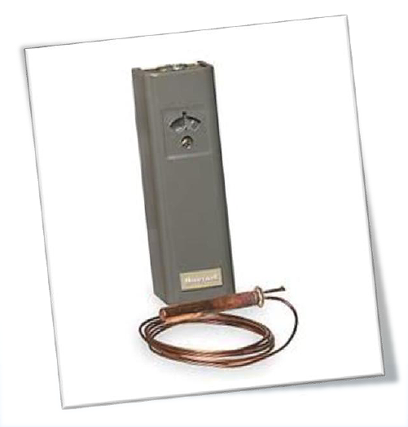
Temperature-Controlled Recirculation
Automatically turns pump on and off based on temperature (usually 120˚)
via a sensor on the return line
It is water sustainable as it keeps the wait for hot water to a minimum,
but is not very energy efficient
Although the pump uses less electricity,
it keeps the distribution loop hot to
maintain the 120˚temperature even
when there is no demand,
creating the same heat losses
as a continuous pump
Slightly more sustainable than
Time Clocks
Sensor

Slide 77
Controlled Recirculation Options &
Their Influence on Sustainability
Time Clocks: A non-sustainable solution, as it runs the pump too much when
it’s “on” creating unnecessary heat losses and runs the pump too little when
it’s “off” creating unnecessary water waste.
Temp regulator: Turn the pump off when there is already hot water in the pipes
(will continue to run the pump during periods of no demand to keep the pipes
constantly hot). It is water sustainable as it keeps the wait for hot water to a
minimum, but not very energy sustainable. Although the pump uses less electricity,
it keeps the distribution hot creating the same heat losses as a continuous pump.
Better than Time Clocks but not the best.
Time/Temp: Combination of time clock and temperature regulator (will run
the pump as needed to keep pipes hot only during the "on" period. Although
this is better than timers or temp regulators standalone, it still has the combination
of the same problems, making it only semi-sustainable.
Although these are not ideal methods for controlled recirculation, controlled
recirculation is always better than no recirculation or continuous recirculation.
Demand Control is the method that solves all these problems.

Slide 78
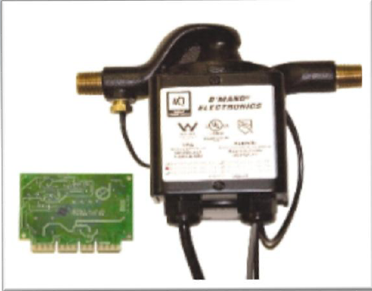
Demand-controlled Recirculation
This method controls recirculation of hot
water according to real-time user demand
within the building or home via an activator.
A demand system returns water in the hot
water pipe to the boiler or water heater
through the cold water line or designated
return line, reducing water waste.
The system uses a thermal sensor so the
fixture demanding hot water only receives
the water when a sensor is activated, reducing energy waste.

Slide 79
Sustained Benefits of Demand Controls
What makes demand controlled recirculation the most sustainable hot water
delivery method?
  • Demand Controls match user demand to the delivery of hot water
  (the pump only runs when the user requires hot water).
  • Get hot water quickly, when you want it
  • Reduces energy use
  • Conserves water
  • Reduces wear and tear on entire water heating system
The U.S. Department of Energy specifically recognizes the efficiency of these
systems as a ―Hot Water Waste Prevention System‖ and ―a novel system
that conserves water and energy.‖

Slide 80
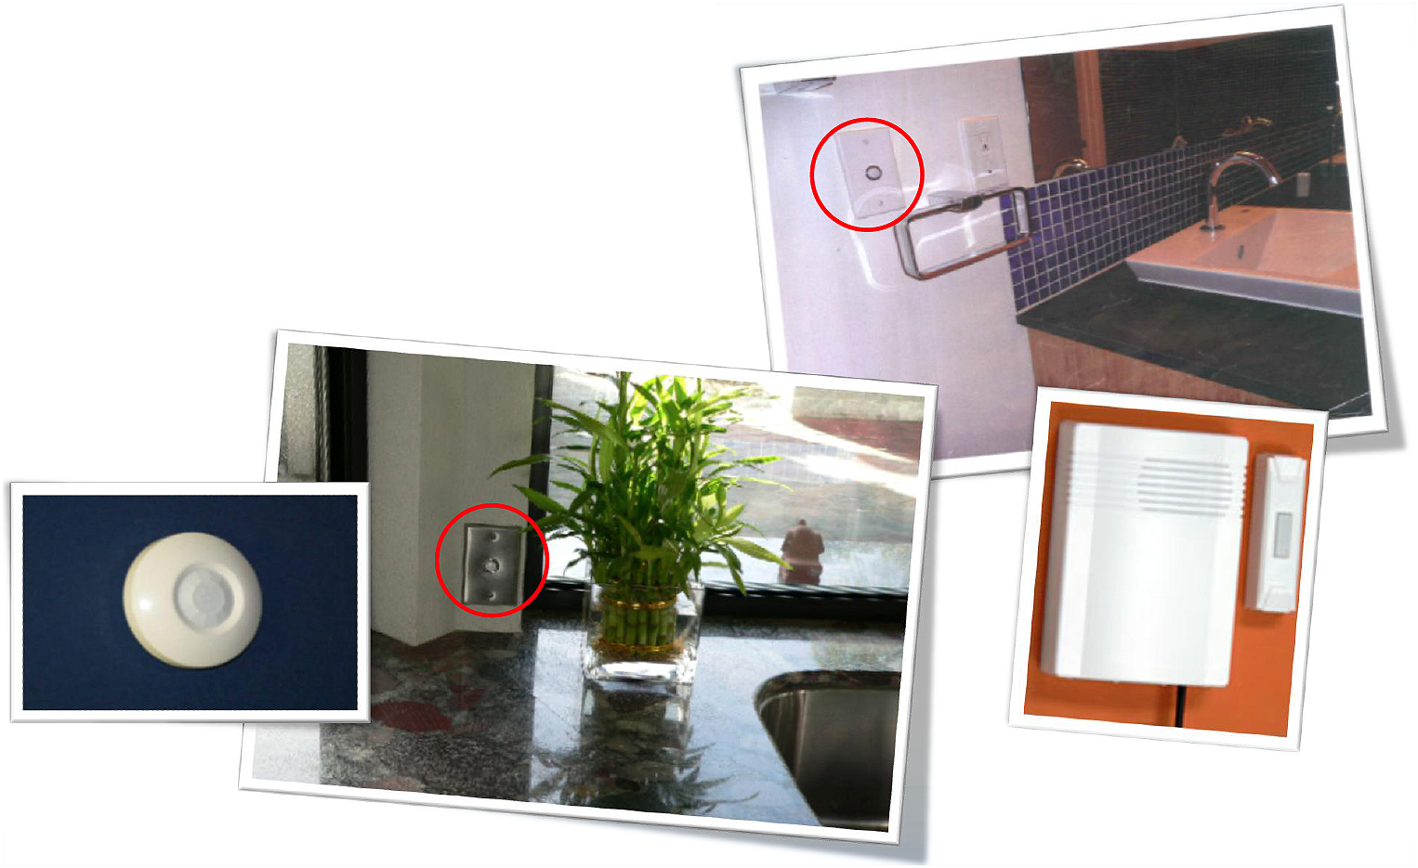
How Is it Activated?
Hardwired push button
Motion sensor
Remote push button

Slide 81
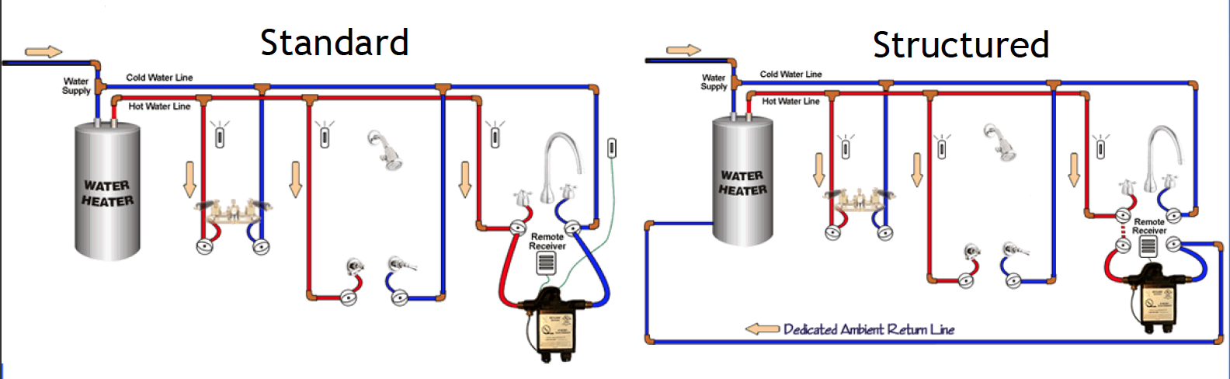
Demand Controlled Pumping Systems
Demand controlled pumping systems work with all hot water heating systems
(tank or tankless, gas or electric) and with either Structured or Standard Plumbing.

Slide 82
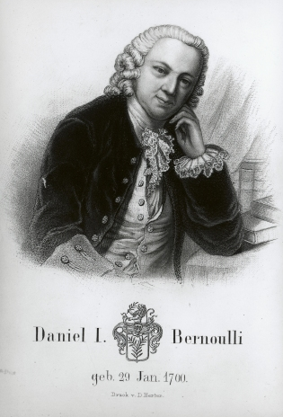
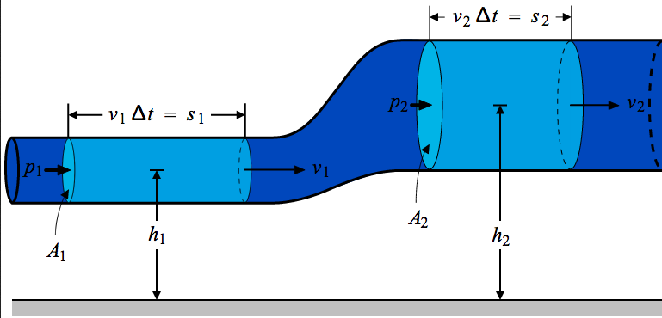
Understanding the Bernoulli Equation
The expression of law of head conservation to the flow of fluid in a conduit or streamline is known as the Bernoulli equation:
The next slide represents the effect of calculating the Bernoulli principle…

Slide 83
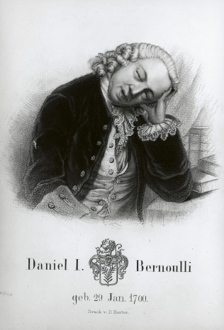
Understanding the Bernoulli Equation
Yeah, it even put Danny Boy to sleep.
You can look it up online:
http://hyperphysics.phy-astr.gsu.edu/hbase/pber.html#bcal
There’s also an online Bernoulli Equation calculator:
http://www.endmemo.com/physics/bernoulli.php

Slide 84

CHAPTER 6
WATER HEATING DESIGN,
EQUIPMENT AND INSTALLATION

Slide 85
601.2 Insulation
Hot water supply and return piping shall be thermally insulated. The wall thickness of the insulation shall be equal to the nominal diameter of the pipe up to 2 inches (50 mm). The wall thickness shall be not less than 2 inches (50 mm) for nominal pipe diameters exceeding 2 inches (50 mm). The conductivity of the insulation [k-factor (Btu•in/(h•ft²•˚F))], measured radially, shall be less than or
equal to 0.28 [Btu•in/(h•ft²•˚F)] [0.04 W/(m•k)]. OY VAY! (not code language) Hot water piping to be insulated shall be installed such that insulation is continuous. Pipe insulation shall be installed to within 1/4 inch (6.4 mm) of all appliances, appurtenances, fixtures, structural members, or a wall where the pipe passes through to connect to a fixture within 24 inches (610 mm). Building cavities shall be large enough to accommodate the combined diameter of the pipe plus the insulation, plus any other objects in the cavity that the piping must cross. Pipe supports shall be installed on the outside of the pipe insulation.

Slide 86
601.2 Insulation
Exceptions:
Where the hot water pipe is installed in a wall that is not of sufficient width to accommodate the pipe and insulation, the insulation thickness shall be permitted to have the maximum thickness that the wall can accommodate and not less than 1/2 inch (12.7 mm) thick.
(2) Hot water supply piping exposed under sinks, lavatories,
and similar fixtures.
(3) Where hot water distribution piping is installed within attic,
crawlspace, or wall insulation.
  (a) In attics and crawlspaces the insulation shall cover
  the pipe not less than 5 inches (140 mm) further
  away from the conditioned space.
  (b) In walls, the insulation must completely surround
  the pipe with not less than 1 inch (25.4 mm) of insulation.
  (c) If burial within the insulation will not completely or
  continuously surround the pipe, then these exceptions
  do not apply.

Slide 87
601.3 Recirculation Systems
601.3.1 Pump Operation.
601.3.1.1 For Low-Rise Residential Buildings.
Circulating hot water systems shall be arranged so that the circulating pump(s) can be turned off (automatically or manually) when the hot water system is not in operation. [ASHRAE 90.2:7.2]
601.3.1.2 For Pumps Between Boilers and Storage Tanks.
When used to maintain storage tank water temperature, recirculating pumps shall be equipped with controls limiting operation to a period from the start of the heating cycle to a maximum of 5 minutes after the end of the heating cycle. [ASHRAE 90.1:7.4.4.4]

Slide 88
601.3 Recirculation Systems
601.3.2 Recirculation Pump Controls.
Pump controls shall include on-demand activation or time clocks combined with temperature sensing. Time clock controls for pumps shall not let the pump operate more than 15 minutes every hour. Temperature sensors shall stop circulation when the temperature set point is reached and shall be located on the circulation loop at or near the last fixture. The pump, pump controls and temperature sensors shall be accessible. Pump operation shall be limited to the building’s hours of operation
601.3.3 Temperature Maintenance Controls.
For other than low-rise residential buildings, systems designed to maintain usage temperatures in hot-water pipes, such as recirculating hot-water systems or heat trace, shall be equipped with automatic time switches or
other controls that can be set to switch off the usage temperature maintenance system during extended periods when hot water is not required. [ASHRAE 90.1:7.4.4.2]

Slide 89
601.3 Recirculation Systems
601.3.4 System Balancing. Systems with multiple recirculation zones shall be balanced to uniformly distribute hot water, or they shall be operated with a pump for each zone. The circulation pump controls shall
comply with the provisions of Section 601.3.2.
601.3.7 Gravity or Thermosyphon Systems.
Gravity or thermosyphon systems are prohibited

Slide 90
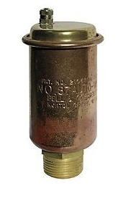
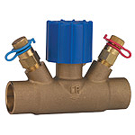


601.3.5 Flow Balancing Valves.
Flow balancing valves shall be a factory preset automatic flow control valve, a flow regulating valve, or a balancing valve with memory stop.
601.3.6 Air Elimination.
Provision shall be made for the elimination of air from the return system.

Slide 91
602.0 Service Hot Water –
Low-Rise Residential Buildings
602.1 General.
The service water heating system for single family houses, multi-family structures of three stories or fewer above grade, and modular houses shall be in accordance with Section 602.2 through Section 602.7. The service water heating system of all other buildings shall be in accordance with Section 603.0.
602.6 Hard Water.
Where water has hardness equal to or exceeding 9 grains per gallon (gr/gal) (154 mg/L) measured as total calcium carbonate equivalents, the water supply line to water heating equipment in new one- and two family
dwellings shall be roughed-in to allow for the installation of water treatment equipment.

Slide 92
602.0 Service Hot Water –
Low-Rise Residential Buildings
602.7 Maximum Volume of Hot Water.
The maximum volume of water contained in the hot water distribution shall comply with Sections 602.7.1 or 602.7.2. The water volume shall be calculated using Table 602.7.
602.7.1 Maximum Volume of Hot Water Without Recirculation or Heat Trace. The maximum volume of water contained in the hot water distribution pipe between the water heater and any fixture fitting shall not exceed 32 ounces (oz) (946 mL). Where a fixture fitting shut off valve (supply stop) is installed ahead of the fixture fitting, the maximum volume of water is permitted to be calculated between the water heater and the fixture fitting shut off valve (supply stop).

Slide 93
602.0 Service Hot Water –
Low-Rise Residential Buildings
602.7.3 Hot Water System Sub meters.
Where a hot water pipe from a circulation loop or electric heat trace line is equipped with a submeter, the hot water distribution system downstream of the submeter shall have either an end-of-line hot water circulation pump or
shall be electrically heat traced. The maximum volume of water in any branch from the circulation loop or electric heat trace line downstream of the submeter shall not exceed 16 oz (473 mL).
If there is no circulation loop or electric heat traced line downstream of the submeter, the submeter shall be located within 2 feet (610 mm) of the central hot water system; or the branch line to the submeter shall be circulated or heat traced to within 2 feet of the submeter. The maximum volume from the submeter to each fixture shall not exceed 32 oz (946 mL).
The circulation pump controls shall comply with the
provisions of Section 601.3.2.

Slide 94
602.0 Service Hot Water –
Low-Rise Residential Buildings
602.7.2 Maximum Volume of Hot Water with Recirculation or Heat Trace. The maximum volume of water contained in the branches between the recirculation loop or electrically heat traced pipe and the fixture fitting shall not exceed a 16 oz (473 mL). Where a fixture fitting shut off valve (supply stop) is installed ahead of the fixture fitting, the maximum volume of water is permitted to be calculated between the recirculation loop or electrically heat traced pipe and the fixture fitting shut off valve (supply stop).
Exception: Whirlpool bathtubs or bathtubs that are not equipped with a shower are exempted from the requirements of Section 602.7.

Slide 95
Table 602.7
Water Volume for Distribution Piping Materials
OUNCES OF WATER PER FOOT LENGTH OF PIPING
NOMINAL SIZE (inch) | Copper M | Copper L | Copper K | CPVC CTS SDR 11 | CPVC SCH 40 | PEX-AL-PEX | PEX-AL- PE | CPVC SCH 80 | PEX CTS SDR 9 | PE SDR 9 | PP SDR 6 | PP SDR 7.3 | PP SDR 11
3⁄8 | 1.06 | 0.97 | 0.84 | NA | 1.17 | 0.63 | 0.63 | NA | 0.64 | 0.64 | 0.91 | 1.09 | 1.24
1⁄2 | 1.69 | 1.55 | 1.45 | 1.25 | 1.89 | 1.31 | 1.31 | 1.46 | 1.18 | 1.18 | 1.41 | 1.68 | 2.12
3⁄4 | 3.43 | 3.22 | 2.90 | 2.67 | 3.38 | 3.39 | 3.39 | 2.74 | 2.35 | 2.35 | 2.23 | 2.62 | 3.37
1 | 5.81 | 5.49 | 5.17 | 4.43 | 5.53 | 5.56 | 5.56 | 4.57 | 3.91 | 3.91 | 3.64 | 4.36 | 5.56
1-1/4 | 8.70 | 8.36 | 8.09 | 6.61 | 9.66 | 8.49 | 8.49 | 8.24 | 5.81 | 5.81 | 5.73 | 6.81 | 8.60
1-1⁄2 | 12.18 | 11.83 | 11.45 | 9.22 | 13.20 | 13.88 | 13.88 | 11.38 | 8.09 | 8.09 | 9.03 | 10.61 | 13.47
2 | 21.08 | 20.58 | 20.04 | 15.79 | 21.88 | 21.48 | 21.48 | 19.11 | 13.86 | 13.86 | 14.28 | 16.98 | 21.39
For SI units: 1 foot = 304.8 mm, 1 ounce = 29.573 mL

Slide 96
Table 603.4.2
Performance Requirements for Water Heating Equipment
EQUIPMENT TYPE | SIZE CATEGORY (INPUT) TEST | SUBCATEGORY OR RATING CONDITION | PERFORMANCE REQUIRED ¹ | TEST PROCEDURE^{2,3}
Electric Table Top Water Heaters | ≤12 kW | Resistance ≥20 gal | 0.93–0.00132V EF | DOE 10 CFR Part 430
Electric water heaters | ≤12 kW | Resistance ≥20 gal | 0.97–0.00132V EF | DOE 10 CFR Part 430
 | >12 kW | Resistance ≥20 gal | 20 + 35√V SL, Btu/h | Section G.2 of ANSI Z21.10.3
 | ≤24 Amps & ≤250 Volts | Heat Pump | 0.93–0.00132V EF | DOE 10 CFR Part 430
Gas Storage Water Heaters | ≤75 000 Btu/h | ≥20 gal | 0.62–0.0019V EF | DOE 10 CFR Part 430
 | >75 000 Btu/h | <4000 (Btu/h)/gal | 80% Et (Q/800 + 110√V) SL, Btu/h | Sections G.1 & G.2 of ANSI Z21.10.3
Gas instantaneous water heaters | >50 000 Btu/h and <200,000 Btu/h | ≥4000 (Btu/h)/gal & <2 gal | 0.62–0.0019V EF | DOE 10 CFR Part 430
 | ≥ 200 000 Btu/h⁴ | ≥4000 (Btu/h)/gal & <10gal | 80% E_{T} | Sections G.1 & G.2 of ANSI Z21.10.3
 | ≥ 200 000 Btu/h | ≥4000 (Btu/h)/gal & >10gal | 80% E_{T} (Q/800 + 110√V) SL, Btu/h
Electronic instantaneous water heaters⁵ | ≤ 12 kW | ≥4000 (Btu/h)/gal & <2 gal | 0.93 – (0.00132•V)EF | DOE 10 CFR Part 430
 | > 12 kW | ≥4000 (Btu/h)/gal & <2 gal | 95% Et | Section G.2 of ANSI Z21.10.3
Oil storage water heaters | ≤ 105,000 Btu/h | ≥20 gal | 0.59-0.0019V EF | DOE 10 CFR Part 430
 | > 105,000 Btu/h | <4000 (Btu/h)/gal | 78% Et (Q/800 + 110√V) SL, Btu/h | Sections G.1 & G.2 of ANSI Z21.10.3

Slide 97
Table 603.4.2
Performance Requirements for Water Heating Equipment
EQUIPMENT TYPE | SIZE CATEGORY (INPUT) TEST | SUBCATEGORY OR RATING CONDITION | PERFORMANCE REQUIRED ¹ | TEST PROCEDURE^{2,3}
Oil Instantaneous Water Heaters | ≤210 000 Btu/h | ≥4000 (Btu/h)/gal & <2 gal | 0.59–0.0019V EF | DOE 10 CFR Part 430
 | >210 000 Btu/h | ≥4000 (Btu/h)/gal & <10gal | 80% E_{T} | Sections G.1 & G.2 of ANSI Z21.10.3
 | >210 000 Btu/h | ≥4000 (Btu/h)/gal & ≥10gal | 78% Et (Q/800 + 110√V) SL, Btu/h
Hot-water supply boilers, gas & oil | ≥300 000 Btu/h and <12 500 000 Btu/h | ≥4000 (Btu/h)/gal & <2 gal | 80% E_{T} | Sections G.1 & G.2 of ANSI Z21.10.3
Hot-water supply boilers, gas | ---------- | ≥4000 (Btu/h)/gal & <10gal | 80% E_{T} (Q/800 + 110√V) SL, Btu/h | Sections G.1 & G.2 of ANSI Z21.10.3
Hot-water supply boilers, oil | ---------- | ≥4000 (Btu/h)/gal & ≥10gal | 78% E_{T} (Q/800 + 110√V) SL, Btu/h | Sections G.1 & G.2 of ANSI Z21.10.3
Pool heaters, oil and gas | All | ≥4000 (Btu/h)/gal & ≥10 gal | 78% E_{T} | ASHRAE 146
Heat Pumps, pool heaters | All | 50.0°F db, 44.2°F wb Outdoor air 80.0°F Entering Water | 4.0 COP | AHRI 1160
Unfired storage tanks | All |  | R-12.5 | (none)
For SI units: 1 gallon = 3.785 L, 1000 British thermal units per hour = 0.293 kW, 1 degree Fahrenheit = t/cº = (t/ºF-32)/1.8
1 Energy factor (EF) and thermal efficiency (Et ) are minimum requirements, while standby loss (SL) is maximum Btu/h (W) based on a 70°F (21ºC)
temperature difference between stored water and ambient requirements. In the EF equation, V is the rated volume in gallons. In the SL equation, V is
the rated volume in gallons and Q is the nameplate input rate in Btu/h.
2 Section 12 of ASHRAE 90.1 contains a complete specification, including the year version, of the referenced test procedure.
3 Section G1 is titled “Test Method for Measuring Thermal Efficiency” and Section G2 is titled “Test Method for Measuring Standby Loss.”
4 Instantaneous water heaters with input rates below 200 000 Btu/h (58.6 kW) must comply with these requirements if the water heater is
designed to heat water to temperatures of 180°F (82ºC) or higher.
5 Not part of ASHRAE 90.1 Table 7-8.

Slide 98
603.0 Service Hot Water –
Other than Low-Rise Residential Buildings
603.2.2 Additions to Existing Buildings.
Service water heating systems and equipment shall comply with the requirements of this section.
Exception: When the service water heating to an addition is provided by existing service water heating systems and equipment, such systems and equipment shall not be required to comply with this supplement. However, any new systems or equipment installed must comply with specific requirements applicable to those systems and equipment. [ASHRAE 90.1:7.1.1.2]
603.2.3 Alterations to Existing Buildings.
Building service water heating equipment installed as a direct replacement for existing building service water heating equipment shall comply with the requirements of Section 603.0 applicable to the equipment being replaced. New and replacement piping shall comply with Section 603.4.3.
Exception: Compliance shall not be required where there is insufficient
space or access to meet these requirements. [ASHRAE 90.1:7.1.1.3]

Slide 99
603.0 Service Hot Water –
Other than Low-Rise Residential Buildings
603.3 Compliance Path(s).
603.3.1 General. Compliance shall be achieved by meeting the requirements of Section 603.1, General; Section 603.4, Mandatory Provisions; Section 603.5, Prescriptive Path; and Section 603.6, Submittals. [ASHRAE 90.1:7.2.1]
603.3.2 Energy Cost Budget Method.
Projects using the Energy Cost Budget Method (Section 11 of ASHRAE 90.1) for demonstrating compliance with the standard shall meet the requirements of Section 603.4, Mandatory Provisions, in conjunction with Section 11 of ASHRAE 90.1, Energy Cost Budget Method. [ASHRAE 90.1:7.2.2]
603.4 Mandatory Provisions.
603.4.1 Load Calculations.
Service water heating system design loads for the purpose of sizing systems and equipment shall be determined in accordance with manufacturers’ published sizing guidelines or generally accepted engineering standards and handbooks acceptable
to the adopting authority (e.g., ASHRAE Handbook – HVAC Applications).
[ASHRAE 90.1:7.4.1]

Slide 100
603.0 Service Hot Water –
Other than Low-Rise Residential Buildings
603.4.2 Equipment Efficiency.
Water heating equipment, hot-water supply boilers used solely for heating potable water, pool heaters, and hot-water storage tanks shall meet the criteria listed in Table 603.4.2. Where multiple criteria are listed, all criteria shall be met. Omission of minimum performance requirements for certain classes of equipment does not preclude use of such equipment where appropriate. Equipment not listed in Table 603.4.2 has no minimum performance requirements.
Exceptions:Water heaters and hot-water supply boilers having more than 140 gallons (530 L) of storage capacity are not required to meet the standby loss (SL) requirements of Table 603.4.2 when:
  (1) The tank surface is thermally insulated to R-12.5.
  (2) A standing pilot light is not installed.
  (3) Gas- or oil-fired storage water heaters have a flue damper or fan-
  assisted combustion. [ASHRAE 90.1:7.4.2]
603.4.3 Insulation. Insulation of hot water and return
piping shall meet the provisions in Section 601.2

Slide 101
603.0 Service Hot Water –
Other than Low-Rise Residential Buildings
603.4.4 Hot Water System Design.
603.4.4.1 Recirculation Systems. Recirculation systems shall meet the provisions in Section 601.3.
603.4.4.4 Maximum Volume of Hot Water.
The maximum volume of water contained in hot water distribution lines between the water heater and the fixture stop or connection to showers, kitchen faucets, and lavatories shall be determined in accordance with Section 602.7.
603.4.5 Service Water Heating System Controls.
603.4.5.1 Temperature Controls.
Temperature controls shall be provided that allow for storage temperature adjustment from 120°F (49ºC) or lower to a maximum temperature compatible with the intended use.
Exception: When the manufacturers’ installation instructions specify a
higher minimum thermostat setting to minimize condensation and
resulting corrosion. [ASHRAE 90.1:7.4.4.1]

Slide 102
603.0 Service Hot Water –
Other than Low-Rise Residential Buildings
603.4.5.2 Outlet Temperature Controls.
Temperature controlling means shall be provided to limit the maximum temperature of water delivered from lavatory faucets in public facility restrooms to
110°F (43ºC). [ASHRAE 90.1:7.4.4.3]
603.4.7 Heat Traps. Vertical pipe risers serving storage water heaters and storage tanks not having integral heat traps and serving a nonrecirculating system shall have heat traps on both the inlet and outlet piping as close as practical to the storage tank. A heat trap is a means to counteract the natural convection of heated water in a vertical pipe run. The means is either a device specifically designed for the purpose or an arrangement of tubing that forms a loop of 360 degrees (6.28 rad) or piping that from the point of connection to the water heater (inlet or outlet) includes a length of piping directed downward before connection to the vertical piping of the supply water or hot-water distribution system, as applicable. [ASHRAE 90.1:7.4.6]

Slide 103
603.0 Service Hot Water –
Other than Low-Rise Residential Buildings
603.5.2 Service Water Heating Equipment. Service water heating equipment used to provide the additional function of space heating as part of a combination (integrated) system shall satisfy all stated requirements for the service water heating equipment. [ASHRAE 90.1:7.5.2]
605.0 Hard Water
605.1 Softening and Treatment.
Where water has hardness equal to or exceeding 10 gr/gal (171 mg/L) measured as total calcium carbonate equivalents, the water supply line to water heating equipment and the circuit of boilers shall be softened or treated to prevent accumulation of lime scale and consequent reduction in energy efficiency.
606.0 Drain Water Heat Exchangers.
Drain water heat exchangers shall comply with IAPMO PS-92. The heat
exchanger shall be accessible.

Slide 104

Insulation Ratings: R value,
K Factor, C Factor and U values
The K Factor
In order to understand the well-known R factor, it is important to understand
the factors upon which it relies. The textbook definition of the K factor is
“The time rate of steady heat flow through a unit area of homogeneous
material induced by a unit temperature gradient in a direction perpendicular
to that unit area.” That’s a mouthful.
Simplified, the K factor is the measure of heat
that passes through one square foot of material
that is 1 inch thick in an hour. Usually, insulation
materials have a K Factor of less than 1. The lower
the K value, the better the insulation.

Slide 105

Insulation Ratings: R value,
K Factor, C Factor and U values
The C Factor
C Factor stands for Thermal Conductance Factor. It’s the quantity of heat,
measured in BTUs, that passes through a foot of insulation material.
Mathematically, it’s the K-factor divided by the thickness of the insulation
material. Just like the K Factor, the lower the C factor, the better the insulating
properties of the material.

Slide 106

Insulation Ratings: R value,
K Factor, C Factor and U values
The R Value
Anyone who purchased insulation for their home knows what the R-factor is.
It’s the number on the outside of the ungainly roll of itchy stuff. However,
unbeknownst to most, the R-factor is not constant. It is the Thermal Resistance
factor of insulation. In layman’s terms, this refers to the effectiveness of the
insulation at retarding the transfer of heat.
The R factor is a variable value that measures
the ability of a material to block heat rather
than radiate it. The variable is the C factor.
Mathematically, the R factor can be determined
by R=1/C. In other words, it is the effectiveness
of the insulation at retarding the transfer of heat.
The higher the R factor, the better the insulation.

Slide 107

Insulation Ratings: R value,
K Factor, C Factor and U values
The U Value
Finally, the term U-Value is the total amount of energy transfer through
convection, radiation and conduction. This is an architectural term used to
describe the energy efficiency of a structure, calculated using a formula
that considers the materials specified for the building envelope—floors,
walls and ceilings.

Slide 108

Might be a while until she gets the hot water…

Slide 109

Voodoo Bath House
Jeff, you could be a success if you could get your head on straight!
This is why the chicken crossed the road…
No wonder we can’t meet a deadline.
Aaaack! I’ve turned into
“The Exorcist!”
We save water the Voodoo way!

Slide 110

Okay, think!
How many code violations can you cite?

Slide 111

The End. But wait for the credits before taking that bathroom break.
(Please go in pairs)

Slide 112


Credits & Acknowledgements
Q= m*Cp*(Thot-Tcold)
Special thanks to Gary Klein for his generous
contribution to a major hunk of this material.
gary@aim4sustainability.com 916‐549‐7080
Thanks to my partner and pal, Paddy Morrissey
For creating this PowerPoint with his Photoshop
and illustration wizardry.
paddymorrissey@comcast.net 510-527-8009
Thanks to the California Energy Commission.
Thank you Laura Biggie, Dave Viola and Tony
Marcello for your sense of humor and
Permission for being Chickens.
Thanks to James Lutz and Koeller and company
For all the research that led to this Chapter and
Presentation.

